Slide 1
What is the book/film about?
Урок английского языка в 9 классе
Автор: Кастуева Залина Тугановна,
учитель английского языка,
МКОУ СОШ №5 г.Беслана

Slide 2
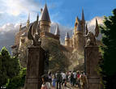
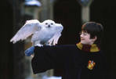
Harry Potter

Slide 3
Harry goes to Hogwarts School.
Hogwarts is a boarding school and Harry spends the whole year there. With its high towers, secret chambers, talking portraits and moving stairs.

Slide 4
There are four houses in the school.
➼Children who have a brave, true heart go to Gryffindor.
➼ Those who are kind and hard-working go to Hufflepuff.
➼ Anyone who is intelligent and loves to learn goes to Ravenclaw.
➼ Someone who is cunning and always gets what he wants goes to Slytherin. A lot of dark wizards came from Slytherin.

Slide 5
Read part 4 and match the names of the school houses with their symbols. Explain you r opinion.
Ravenclaw
Gryffindor
Slytherin
Hufflepuff

Slide 6
Which houses will these people go to?

Slide 7
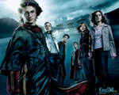
Harry Potter
Bye-Bye

